Slide 1
Bakery Database
Created by. Kholod

Slide 2






Bakery Database
In this environment there are many information they should be organized and stored So, we create database has four tables for primary information.
Employees Table
Products table
Order Invoice table
Sales
table
Created by. Kholod

Slide 3
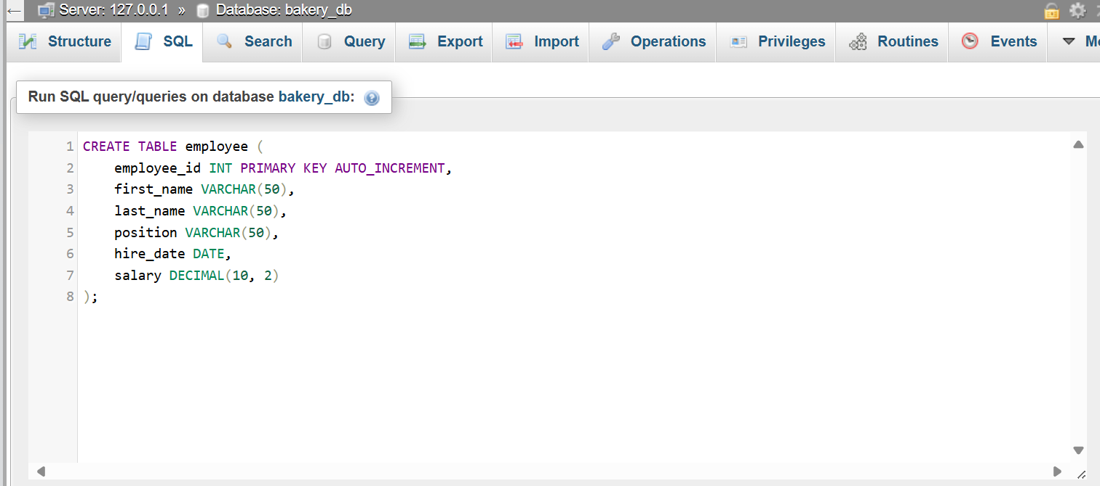
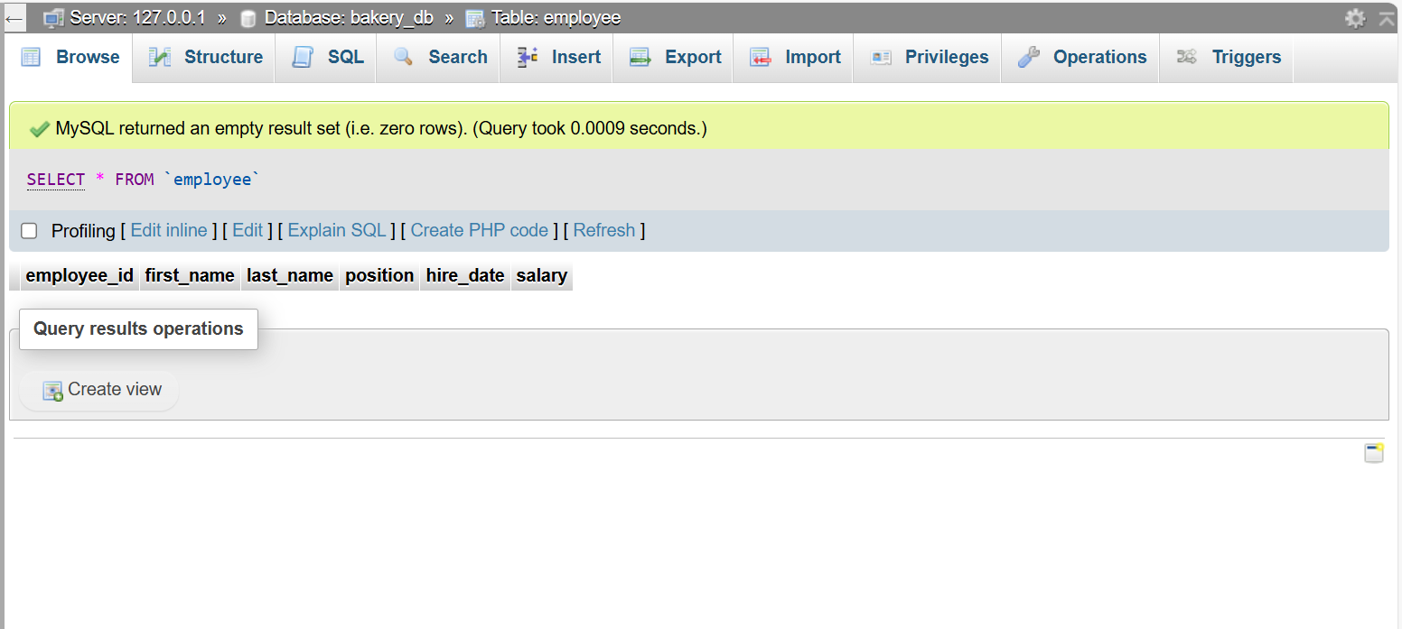
Employees Table
Create Employee Table
Halimah Abutaleb is responsible for this table
Created by. Kholod

Slide 4
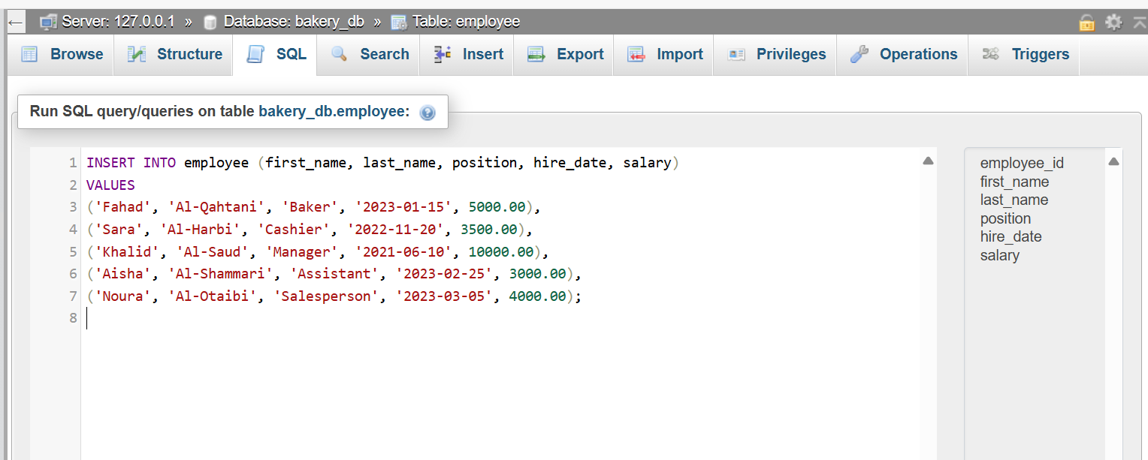
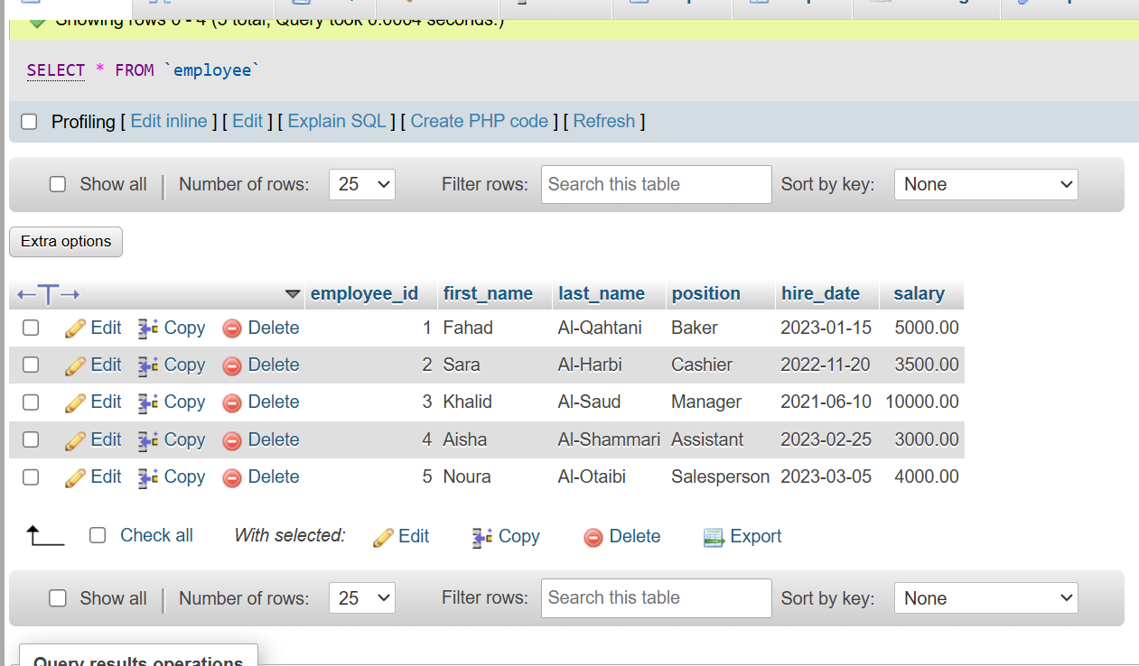
Employees Table
Insert data into Employee Table
Halimah Abutaleb is responsible for this table
Created by. Kholod

Slide 5
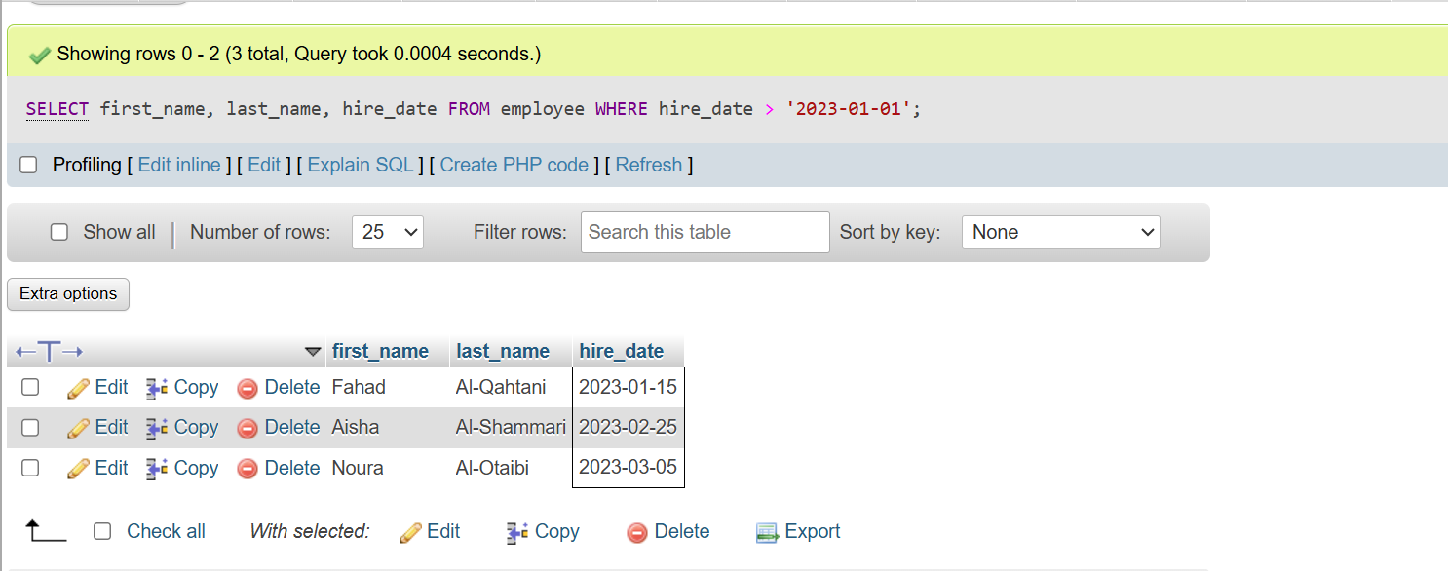
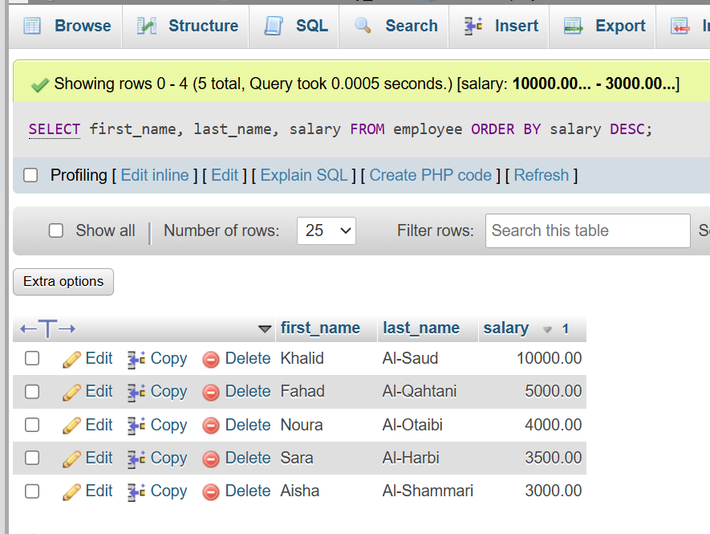
Employees Table
Select from Employee Table
Display the first and last names and dates of employment of employees hired after this date.
Display the columns first_name, last_name, and salary from the employee table, where the results are sorted by the salary column in descending order (DESC).
Halimah Abutaleb is responsible for this table
Created by. Kholod

Slide 6
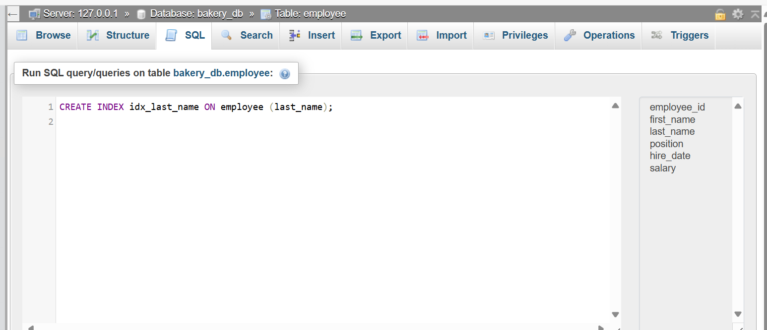
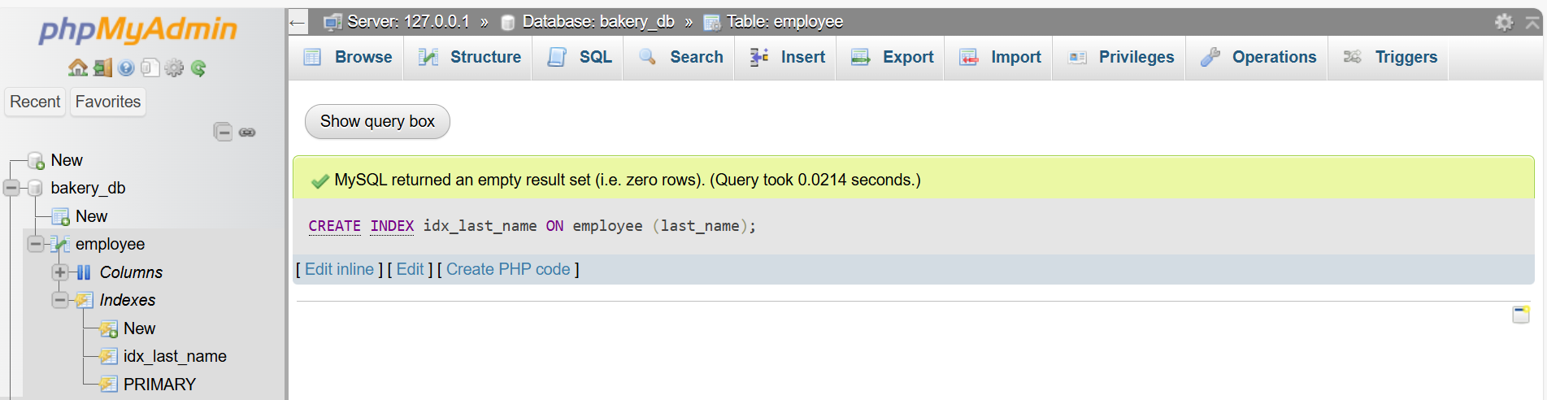
Employees Table
Create Index
Halimah Abutaleb is responsible for this table
Created by. Kholod

Slide 7
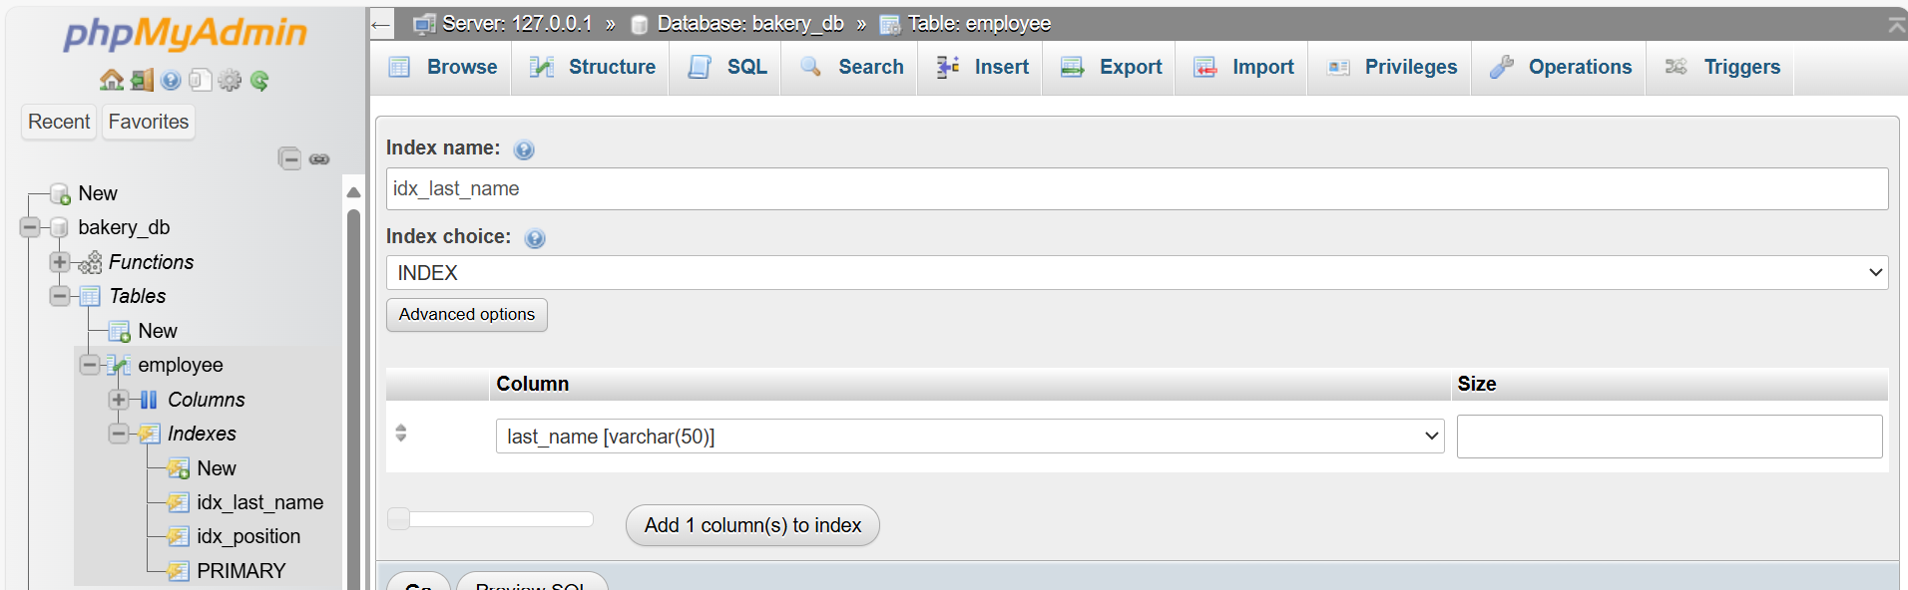
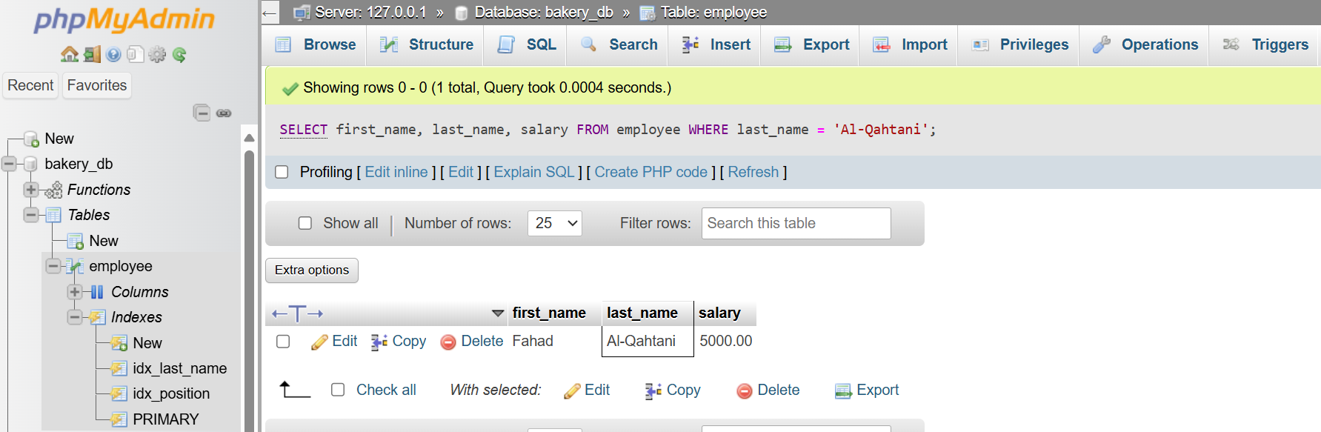
Employees Table
Using Index
Halimah Abutaleb is responsible for this table
Created by. Kholod

Slide 8
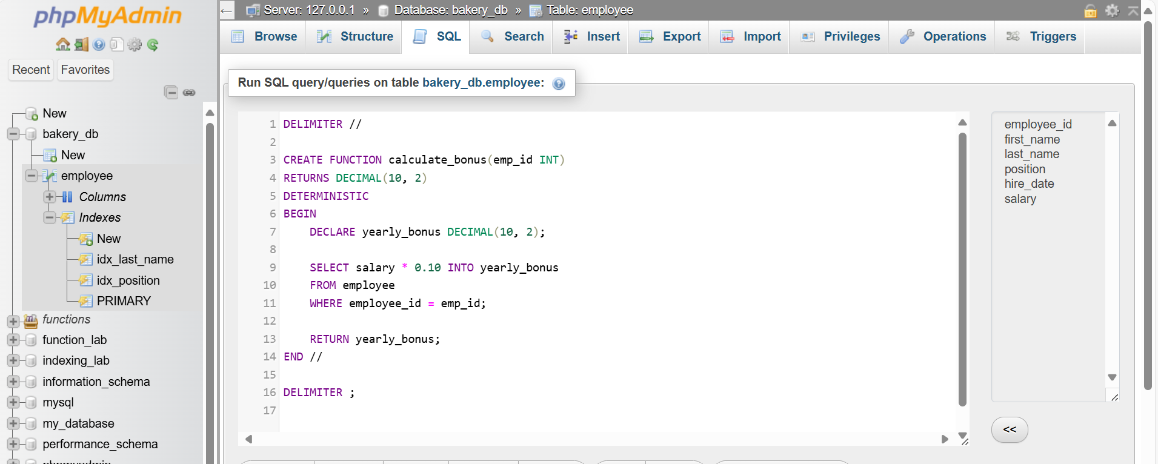
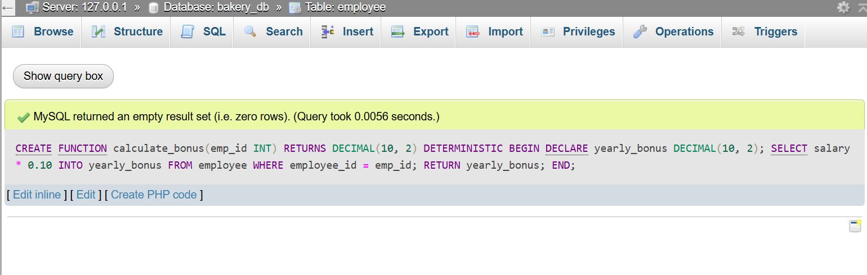
Employees Table
Create Function
This function calculates an annual bonus equal to 10% of a specific employee's salary based on the employee's identification number (emp_id). RETURN yearly_bonus returns the calculated annual bonus value.
Halimah Abutaleb is responsible for this table
Created by. Kholod

Slide 9
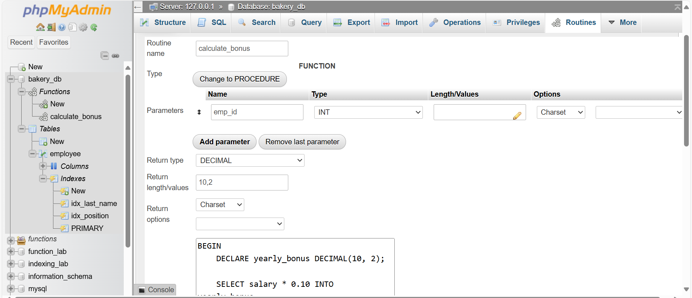
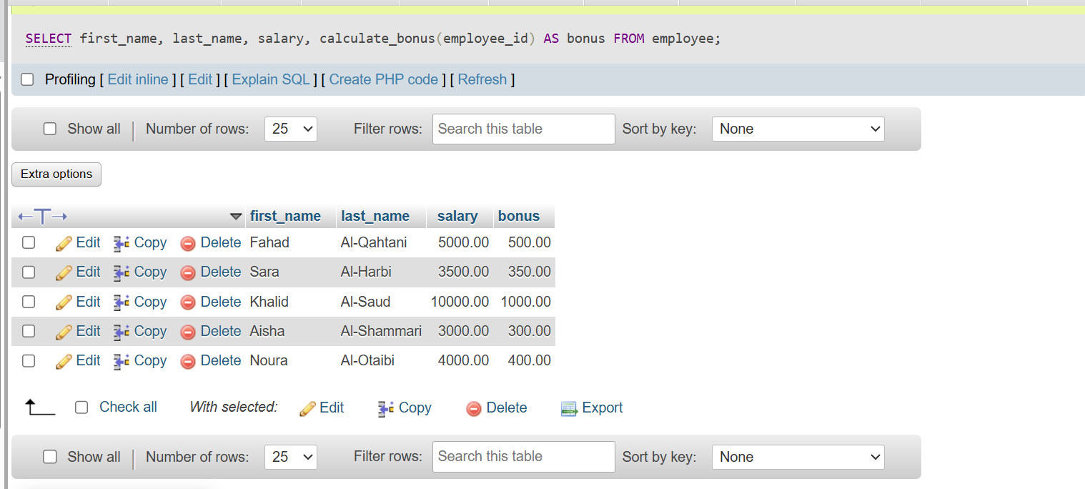
Employees Table
Call Function
Halimah Abutaleb is responsible for this table
Created by. Kholod

Slide 10
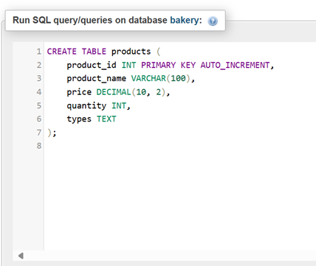
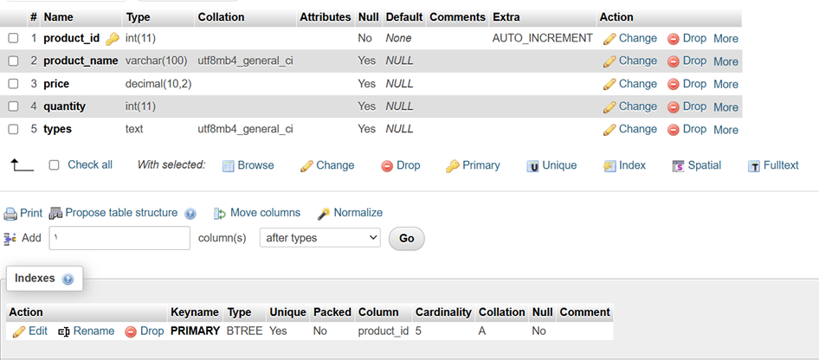



Products Table
Create Products Table
Raghad Hassan is responsible for this table
Created by. Kholod

Slide 11
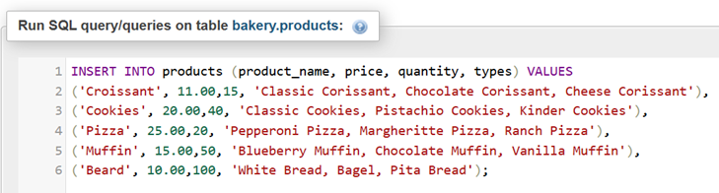
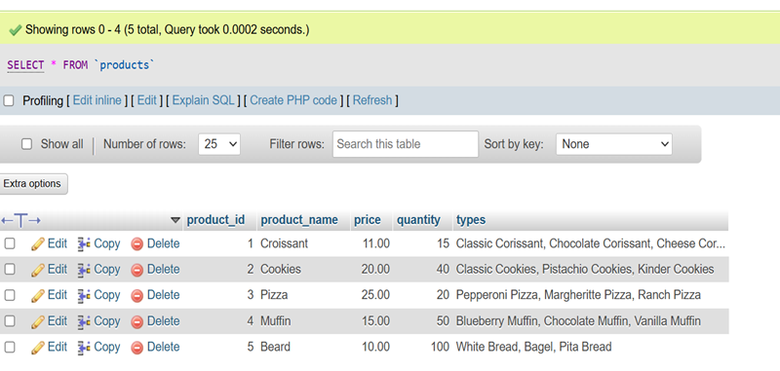
Products Table
Insert data into Products Table
Raghad Hassan is responsible for this table
Created by. Kholod

Slide 12
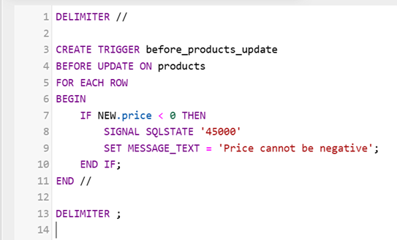
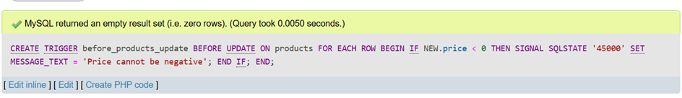
Products Table
Create a Trigger for Price Validation
Raghad Hassan is responsible for this table
Created by. Kholod

Slide 13
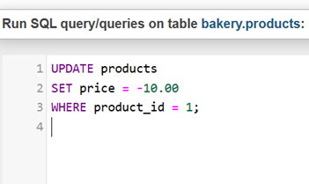
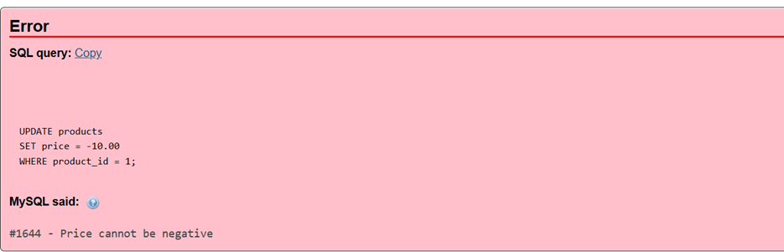
Products Table
Test Trigger
Raghad Hassan is responsible for this table
Created by. Kholod

Slide 14
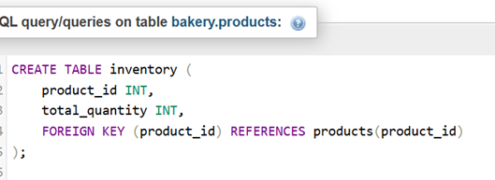
Products Table
Create a Trigger for Quantity Tracking
Raghad Hassan is responsible for this table
Created by. Kholod

Slide 15
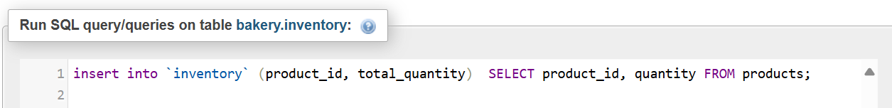
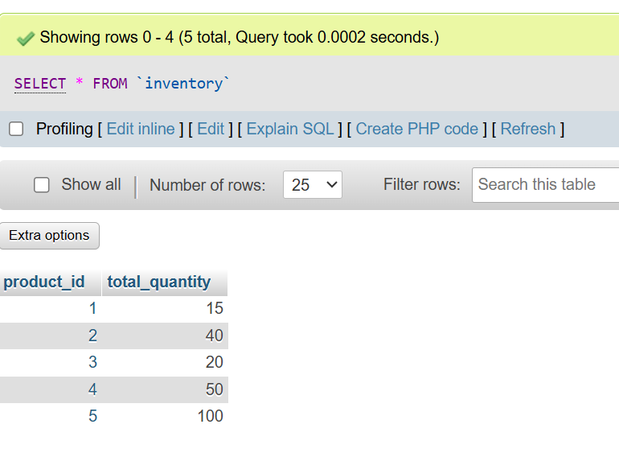
Products Table
Trigger for Quantity Tracking
Raghad Hassan is responsible for this table
Created by. Kholod

Slide 16
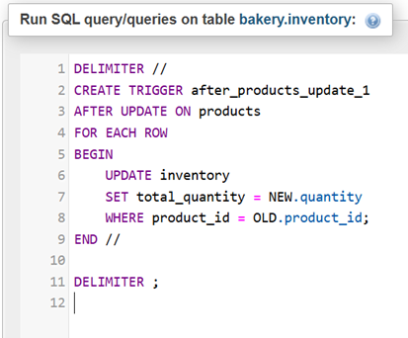
Products Table
Create a Trigger after_products_update:
Raghad Hassan is responsible for this table
Created by. Kholod

Slide 17
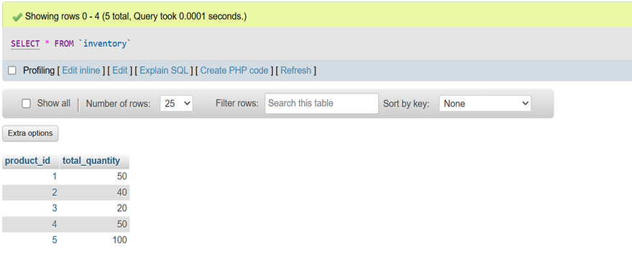
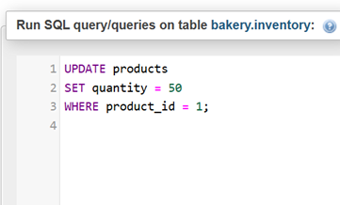
Products Table
Test Trigger
Raghad Hassan is responsible for this table
Created by. Kholod

Slide 18
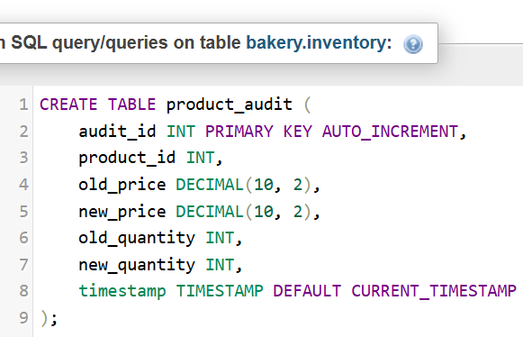
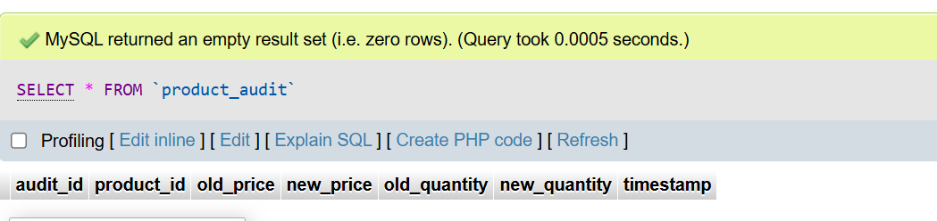
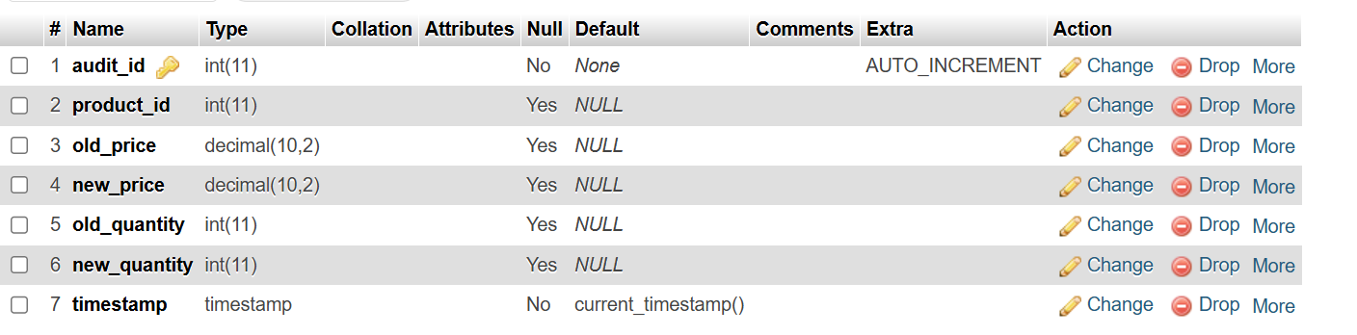
Products Table
Create a Trigger for Auditing
Raghad Hassan is responsible for this table
Created by. Kholod

Slide 19
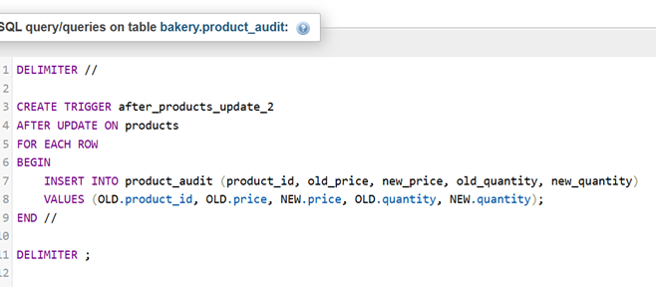
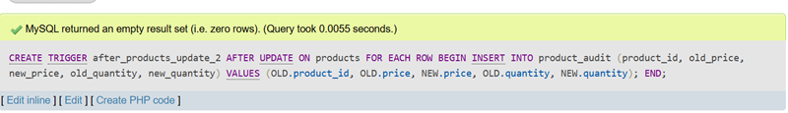
Products Table
Create a Trigger for Auditing
Raghad Hassan is responsible for this table
Created by. Kholod

Slide 20
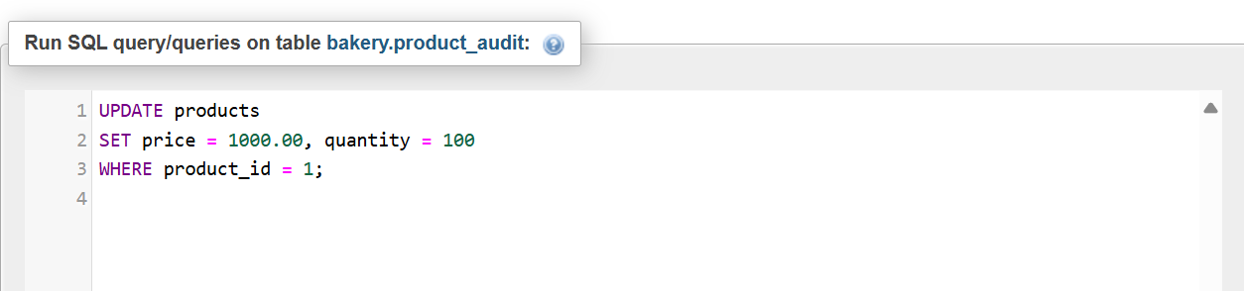
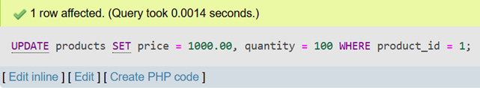
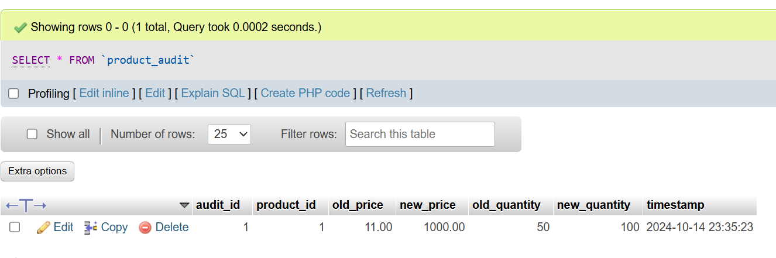
Products Table
Test Trigger
Raghad Hassan is responsible for this table
Created by. Kholod

Slide 21
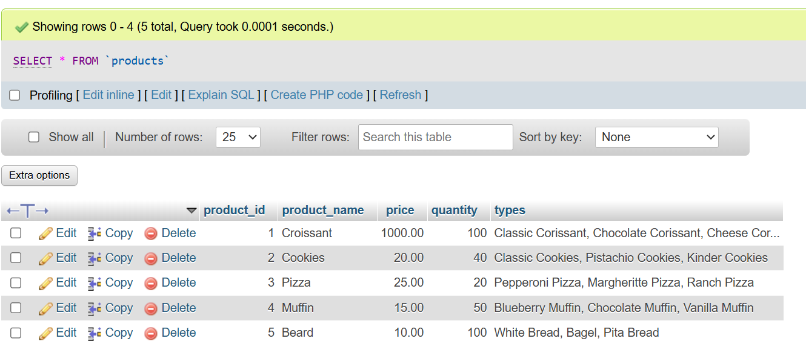
Products Table
Select from Product table
Raghad Hassan is responsible for this table
Created by. Kholod

Slide 22
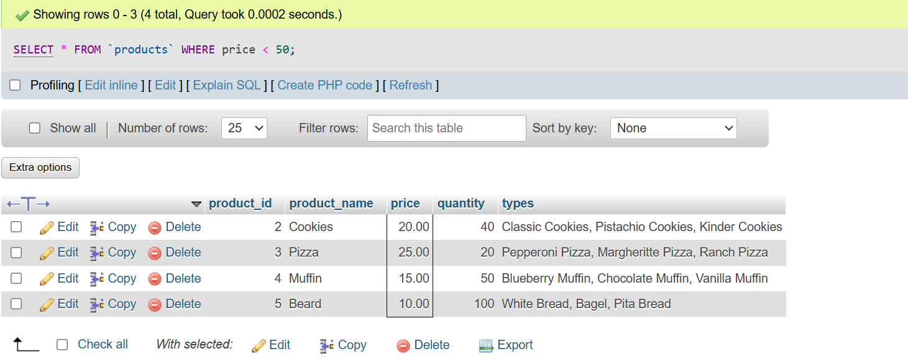
Products Table
Select Where from Product table
Raghad Hassan is responsible for this table
Created by. Kholod

Slide 23
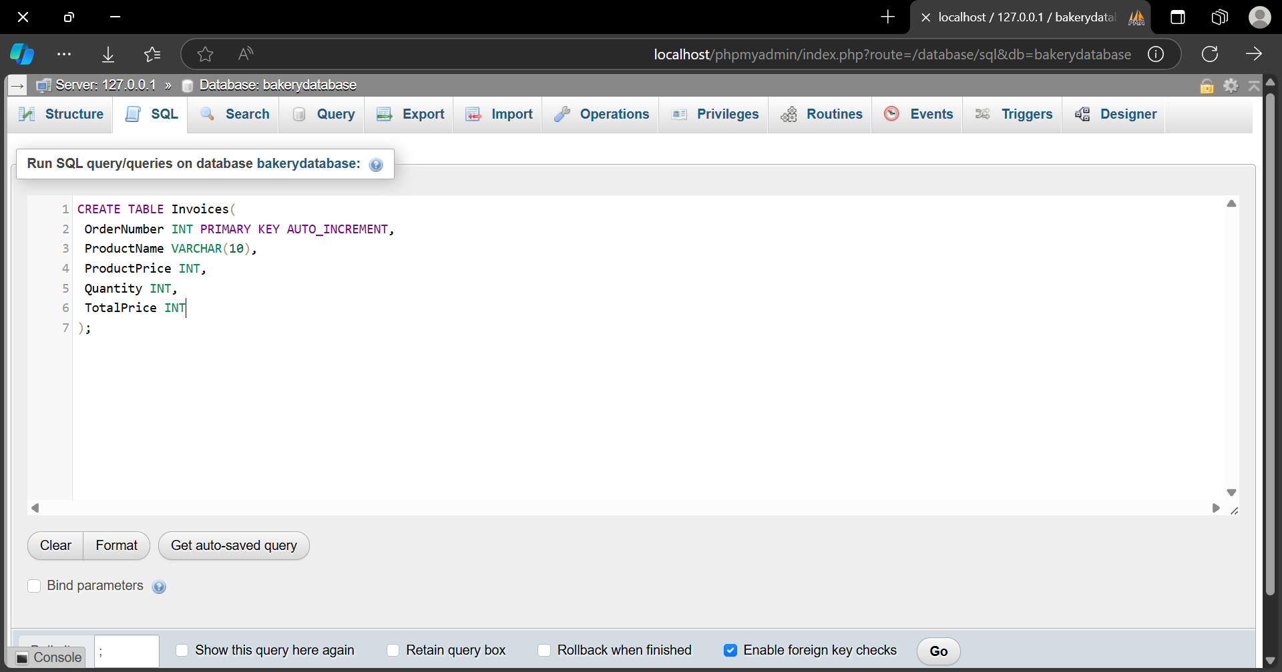
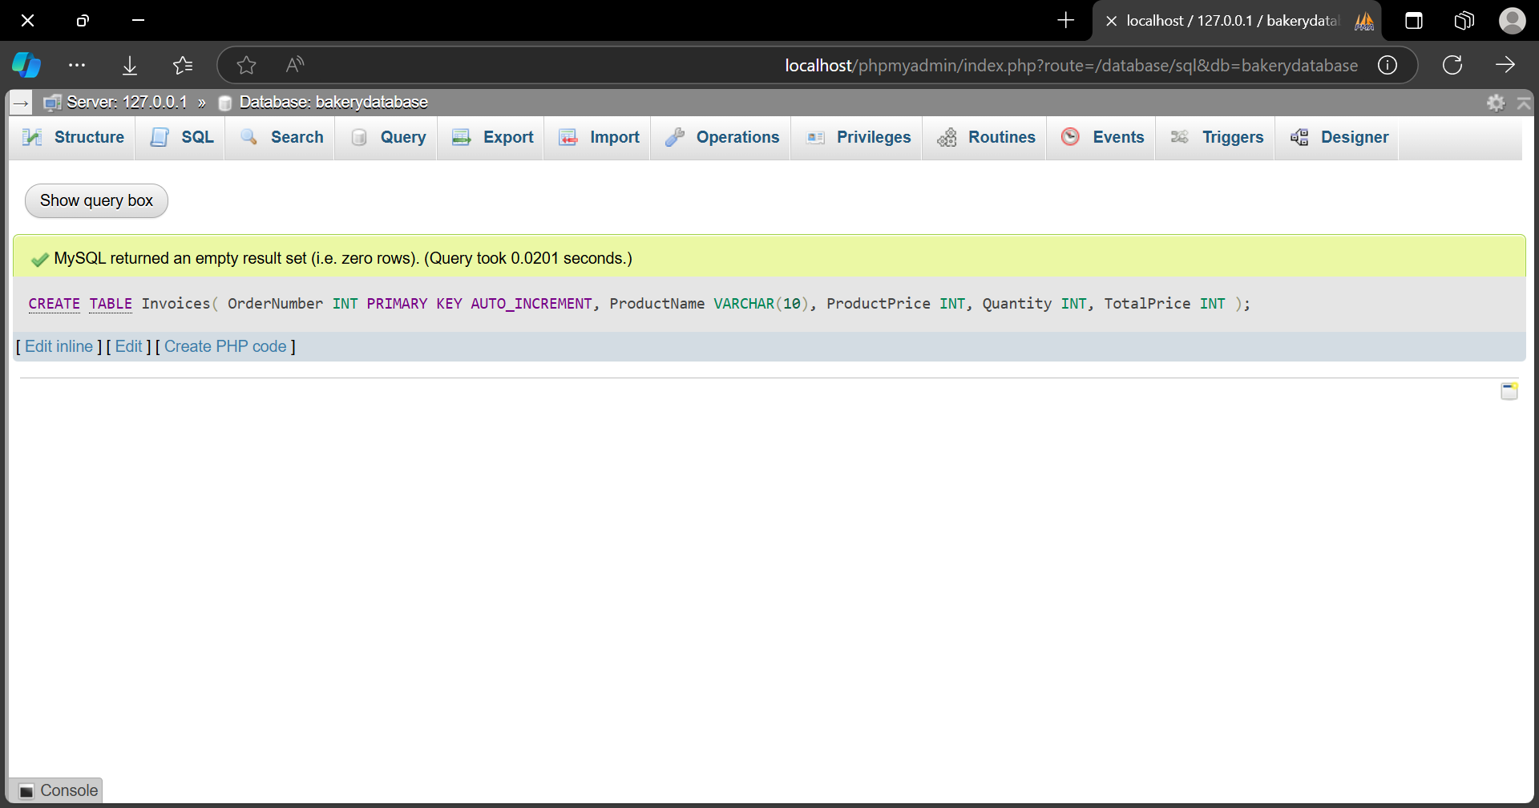

Order Invoice Table
Create Order Invoice Table
Kholod Madini is responsible for this table
Created by. Kholod

Slide 24
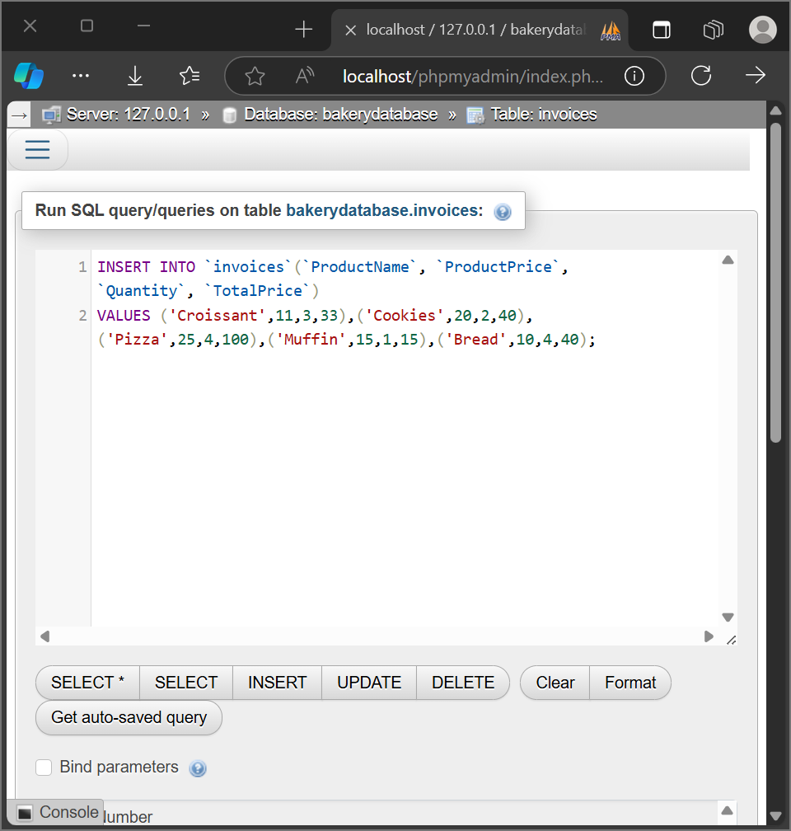
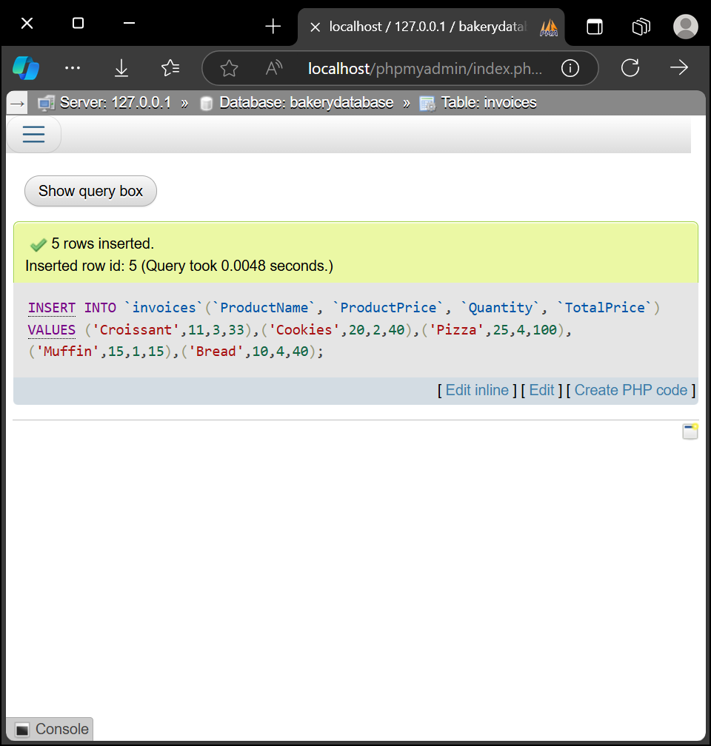
Order Invoice Table
Insert data into Order Invoice Table
Kholod Madini is responsible for this table
Created by. Kholod

Slide 25
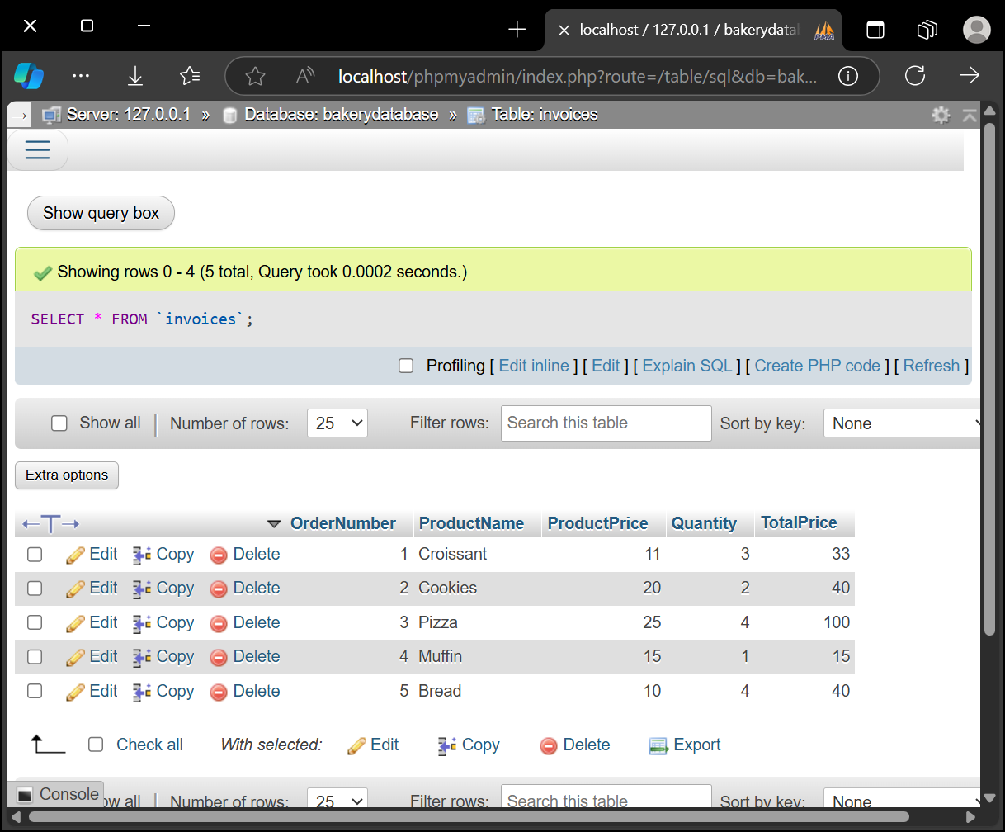
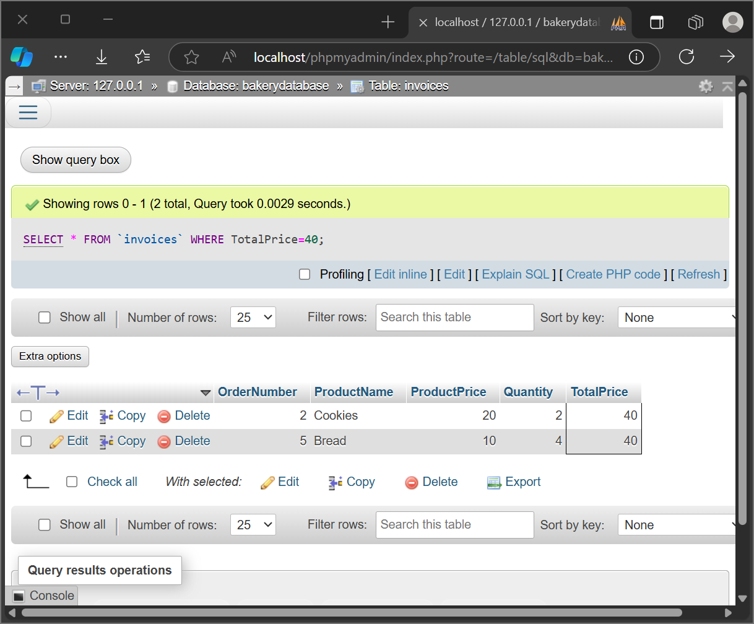
Order Invoice Table
Select from Order Invoice Table
Kholod Madini is responsible for this table
Created by. Kholod

Slide 26
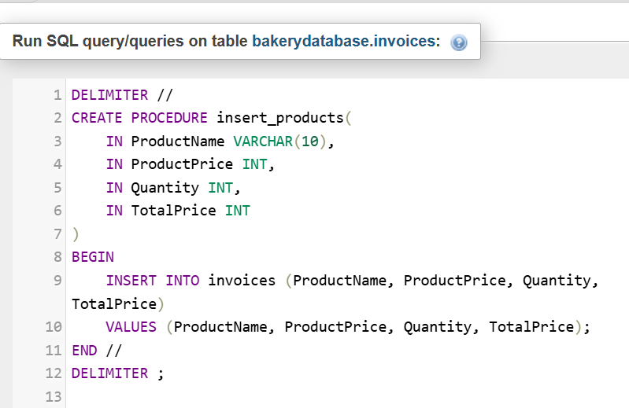
Order Invoice Table
Create a Stored Procedure for Insertion
Kholod Madini is responsible for this table
Created by. Kholod

Slide 27
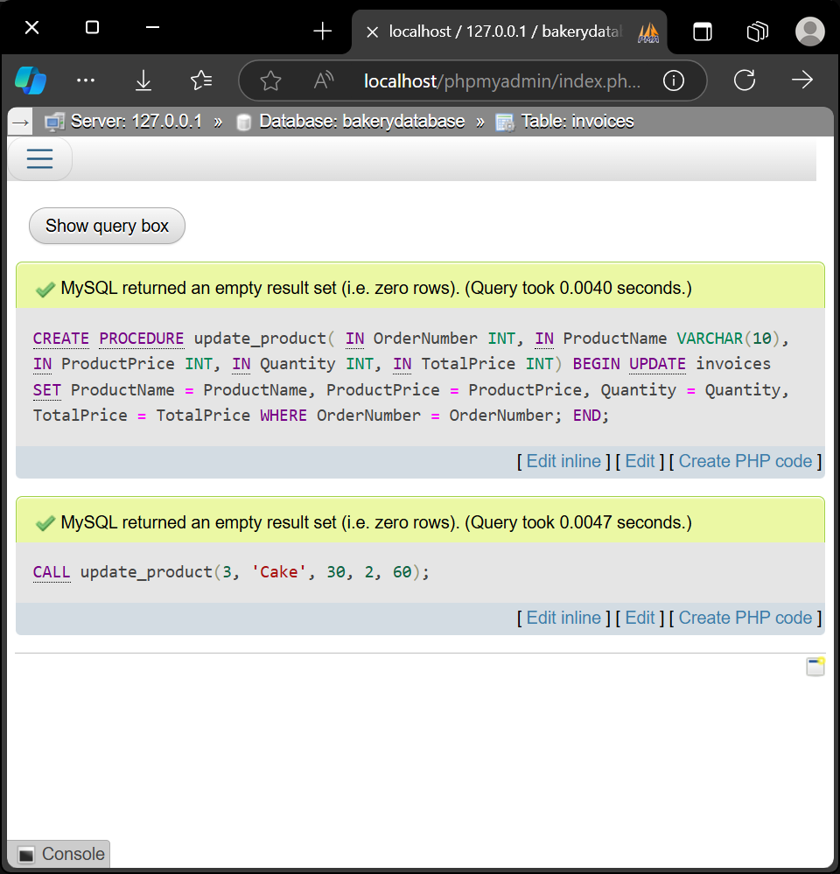
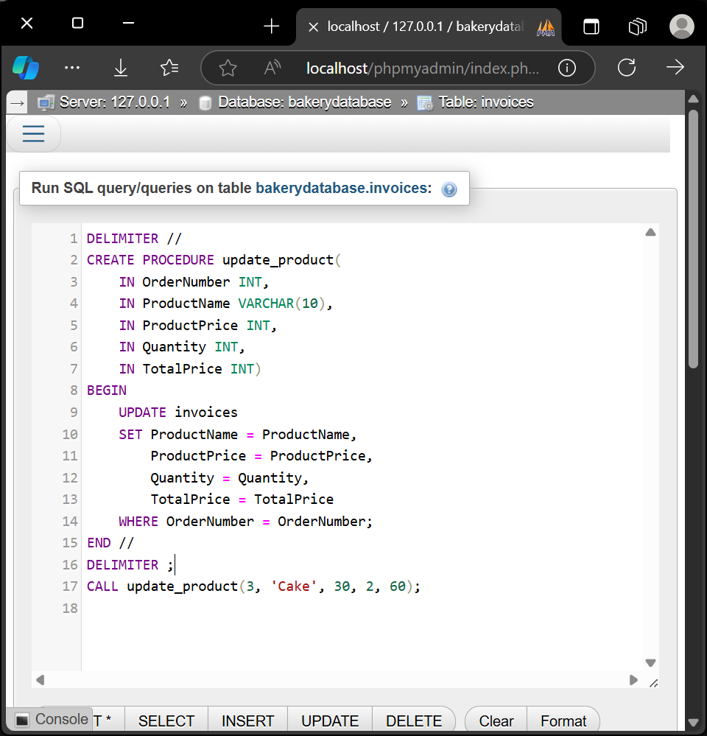
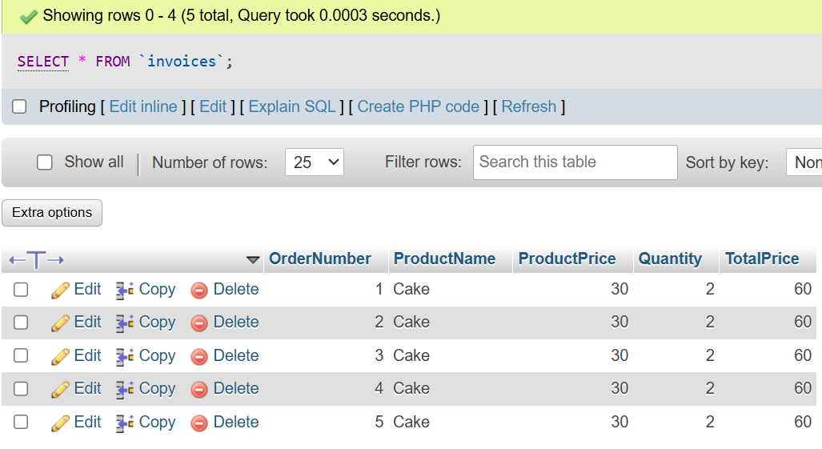
Order Invoice Table
Create a Stored Procedure for Updating with calling
Kholod Madini is responsible for this table
Created by. Kholod

Slide 28
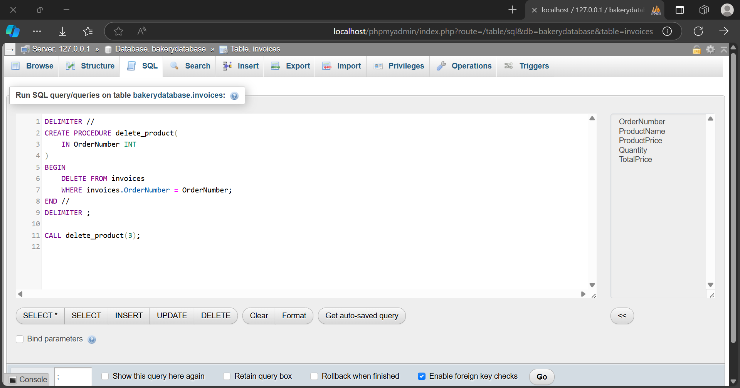
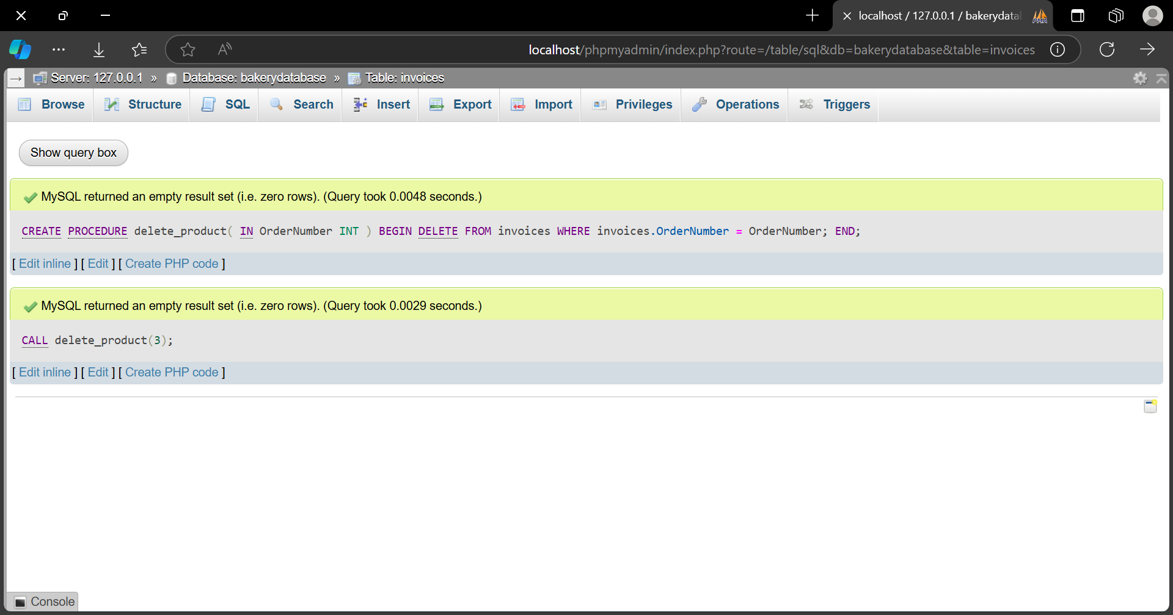

Order Invoice Table
Create a Stored Procedure for Deletion with calling
Kholod Madini is responsible for this table
Created by. Kholod

Slide 29

Sales Table
Create Sales Table
Wejdan Attia is responsible for this table
Created by. Kholod

Slide 30

Sales Table
Insert data into Sales Table
Wejdan Attia is responsible for this table
Created by. Kholod

Slide 31


Sales Table
Select from Sales Table
Wejdan Attia is responsible for this table
Created by. Kholod

Slide 32



Sales Table
Simple Transaction
Wejdan Attia is responsible for this table
Created by. Kholod

Slide 33



Sales Table
Rollback Transaction
Wejdan Attia is responsible for this table
Created by. Kholod

Slide 34

Sales Table
Concurrent Updates Without Concurrency Control
Wejdan Attia is responsible for this table
Created by. Kholod

Slide 35

Sales Table
Deadlock
Wejdan Attia is responsible for this table
Created by. Kholod

Slide 36
That’s it :)
Created by. Kholod

